Slide 1
National Institute of Technology, Tiruchirappalli
Department of Mechanical Engineering
MEPE22: MEMS Devices–Design and Fabrication
Assignment No. 2
Project Title: AEROSENSE-A Silicon-Carbide Schottky Diode Gas Sensor for Aerospace Applications
Group No. 5 (ME-A)
Aditya Pratap Singh-111122005
Ankur Das-111122013
Sunil Kumawat-111122127

Slide 2

Material Selection
AEROSENSE represents innovation in gas sensing technology, specifically tailored for demanding aerospace applications. Gas sensors are critical components in aerospace engineering, tasked with detecting and monitoring various gases in challenging environments characterized by high temperatures, pressure differentials, and potentially corrosive atmospheres.
The sensor is designed to address these challenges by leveraging the unique properties of silicon carbide (SiC) as the semiconductor material, offering high thermal conductivity, mechanical strength, and chemical inertness. This enables the sensor to operate at temperatures exceeding 400°C, surpassing the capabilities of conventional silicon-based sensors.
Additionally, the sensor incorporates innovative materials such as palladium oxide (PdOx) as a barrier layer to enhance reliability and stability, ensuring long-term performance in harsh aerospace environments.
The following slides discusses about the different materials used for sensor fabrication along with their material properties, advantages, disadvantages etc.

Slide 3
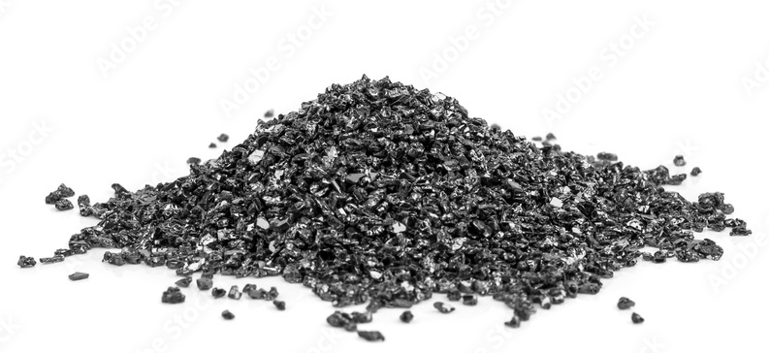

Substrate : Silicon Carbide (SiC)
The substrate material serves as the foundation for the sensor structure, providing mechanical support and acting as a base for other layers to be deposited on. Silicon Carbide (SiC) is used as the substrate material.
SiC Crystals (granulated)
Properties: SiC exhibits high thermal conductivity, mechanical strength, and chemical inertness. These properties make it well-suited for high-temperature and harsh-environment applications, such as aerospace.
Advantages: SiC can withstand high temperatures, making it ideal for use in aerospace applications where temperature extremes are common. It also offers excellent chemical inertness, ensuring the sensor's stability in corrosive environments.
Limitations: SiC can be more expensive than other substrate materials, such as silicon. Additionally, the processing techniques for SiC are more complex, which can increase manufacturing costs.
Silicon Carbide Wafers (4H N-type)

Slide 4
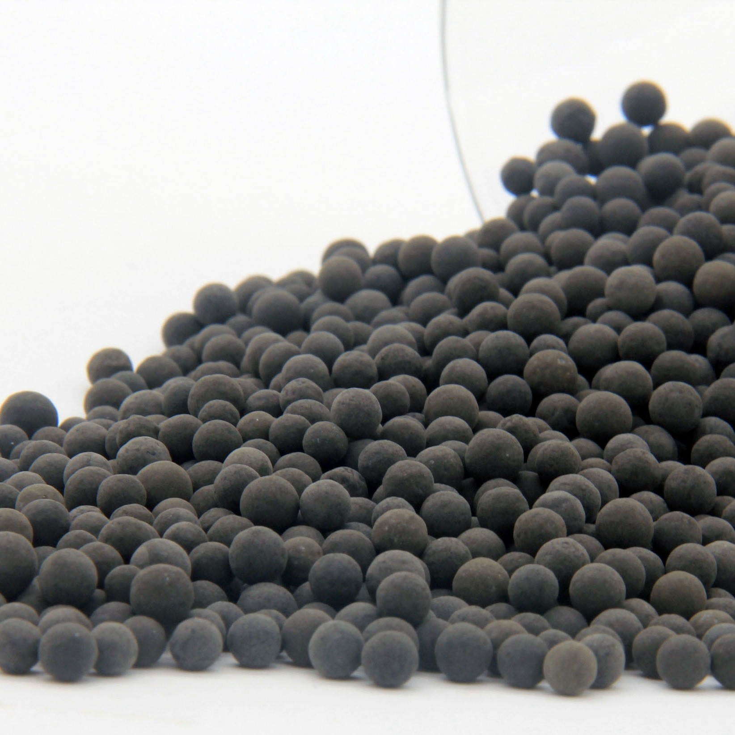

Catalytic/Physisorptive Layer : Palladium (Pd)
The catalytic/physisorptive layer is responsible for interacting with gases and catalytically dissociating them into atomic species. This interaction leads to changes in the electrical properties of the sensor, which can be measured to detect the presence of gases. Palladium (Pd) is used for this purpose.
Pd Catalyst (granulated)
Properties: Pd has a high affinity for hydrogen and exhibits catalytic properties, making it suitable for hydrogen detection in gas sensors.
Advantages: Pd is highly selective for hydrogen, allowing for accurate detection even in the presence of other gases. It also offers good sensitivity and response time.
Limitations: Pd can be relatively expensive, which can increase the cost of manufacturing sensors. Additionally, the catalytic properties of Pd may degrade over time, affecting sensor performance.
Pd-C Layer (Nanocomposite)

Slide 5
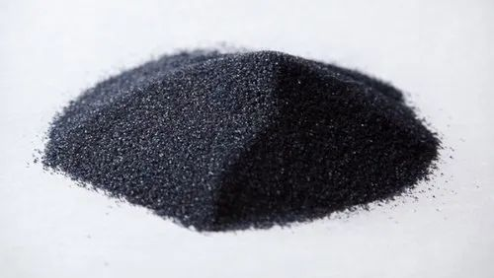
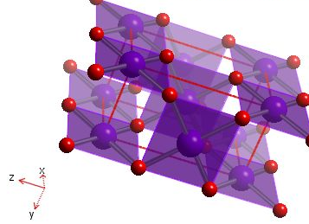
Barrier Layer : Palladium Oxide (PdO_{x})
The barrier layer acts as a protective layer between the catalytic layer and the substrate. It prevents reactions between the catalytic layer and the substrate, ensuring the long-term stability and reliability of the sensor. Palladium Oxide (PdO_{x}) is used for this purpose.
PdO_{x} Crystals (powdered)
Properties: PdO_{x} is inert and compatible with the sensor structure, making it suitable for use as a barrier layer.
Advantages: PdO_{x} prevents reactions between the catalytic layer and the substrate, ensuring the sensor's stability and reliability over time.
Limitations: The thickness of the PdO_{x} layer must be carefully controlled to avoid affecting sensor performance. Additionally, the deposition process for PdO_{x} can be complex, increasing manufacturing complexity and cost.
PdO₂ Crystal Structure

Slide 6
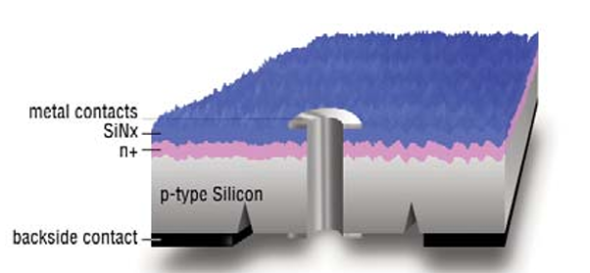
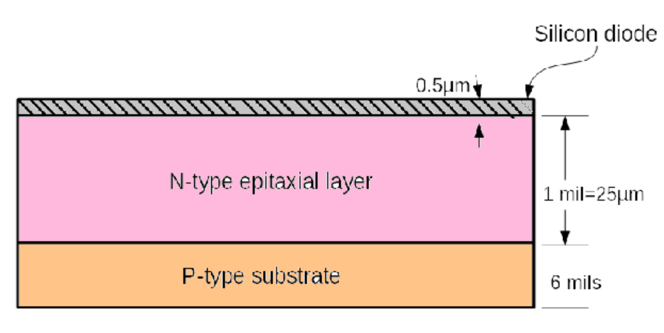
Additional Elements
Backside Contact: The backside contact of the sensor is typically formed using sputter-deposited titanium and nickel layers. This contact serves as one of the electrodes of the Schottky diode structure, allowing for the application of a bias voltage across the diode.
N-Type Epilayer: The sensor is fabricated using an n-type SiC wafer, which is typically grown using a process called epitaxy (epilayer). Epitaxy involves depositing a thin layer of semiconductor material onto a substrate, which in this case is the SiC wafer. The n-type epilayer refers to the type of doping used in this layer, where the material is doped with impurities to create an excess of negative (electron) charge carriers.
N-type Epitaxial Layer on P-type Substrate

Slide 7

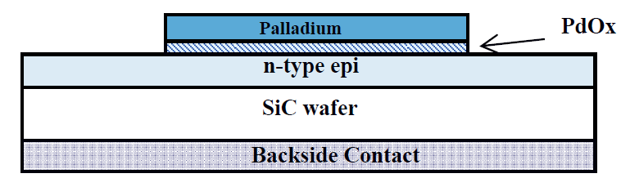
Working Principle
The sensor system employs a Schottky diode gas sensor platform, comprising a catalytic layer (Pd), a semiconductor (SiC), and a thin insulating layer (PdO_{x}) between them, along with a backside contact. This design enables the detection of gases such as hydrogen (H₂) with high sensitivity and wide detection ranges.
The operational principle begins with the interaction of target gas molecules (H₂ or C_{x}H_{y}) with the Pd catalytic layer. Upon contact, these molecules dissociate, releasing atomic hydrogen. This hydrogen is adsorbed into the Pd layer, forming a dipole layer at the Pd/PdO_{x} interface. This process induces a change in the electrical properties of the diode, specifically altering its current, which is proportional to the concentration of the hydrogen gas.
By applying a bias voltage to the diode through the Pd layer, either forward or reverse current can flow. The thin PdO_{x} barrier layer allows for tunneling, creating the Schottky diode structure. The change in current, resulting from the interaction of hydrogen with the Pd layer, serves as a measurable indicator of the gas concentration.
Sensor Structure

Slide 8
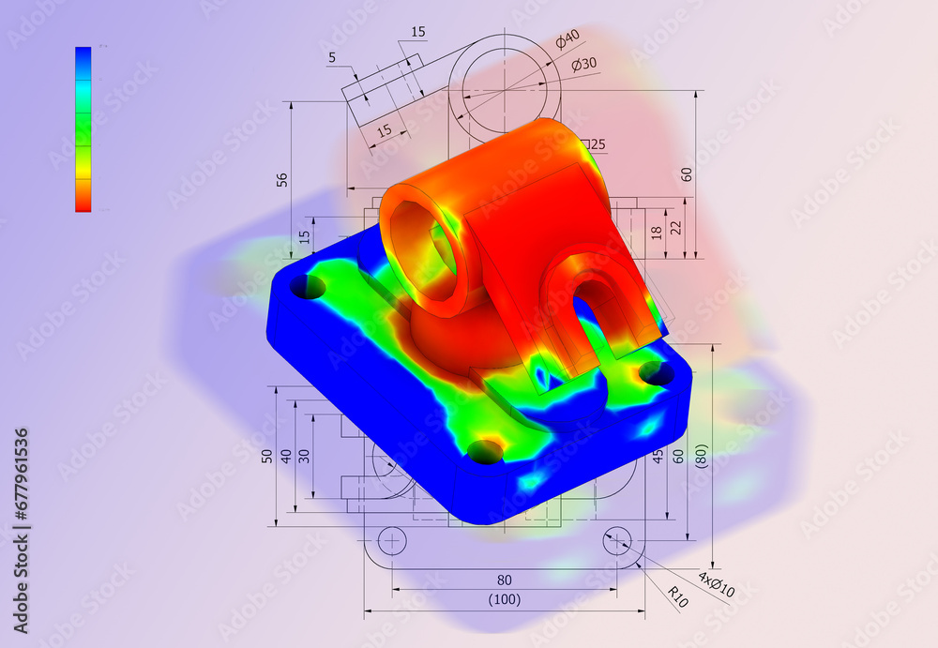
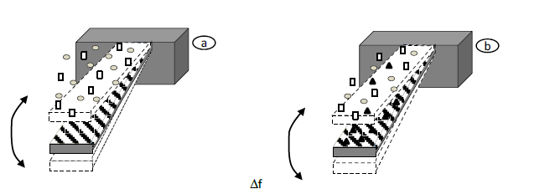
Structural Analysis : Overview
We are interested in understanding the operation of a SiC Schottky diode gas sensor. For this, we employ an analytical model for determining the concentration of gas using principles and theories of solid mechanics. The overview of our objective can be summarized as follows:
The model is based on the fact that the sensor operates on the deflection of a microcantilever beam coated with a suitable chemisorptive (or) catalytic layer. This deflection is induced due to the change in surface tension as a result of selective adsorption of gas molecules. Our goal is to analytically backtrace the gas concentration based on the voltage output from a displacement sensor measuring the deflection of the microcantilever beam.

Slide 9
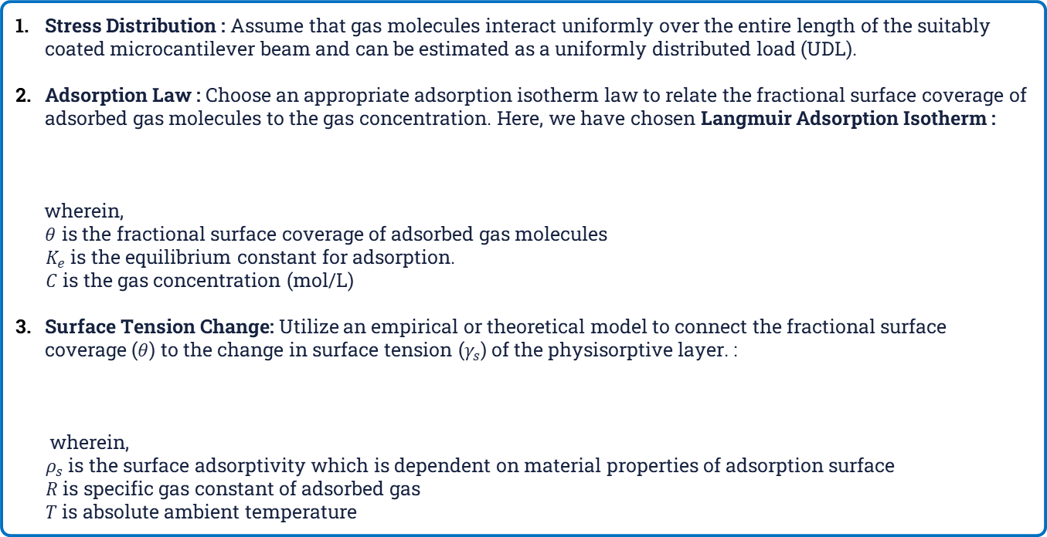


Structural Analysis : Modelling Methodology
Stress Distribution : Assume that gas molecules interact uniformly over the entire length of the suitably coated microcantilever beam and can be estimated as a uniformly distributed load (UDL).
Adsorption Law : Choose an appropriate adsorption isotherm law to relate the fractional surface coverage of adsorbed gas molecules to the gas concentration. Here, we have chosen Langmuir Adsorption Isotherm :
wherein,
$θ$ is the fractional surface coverage of adsorbed gas molecules
${ K}_{e}$ is the equilibrium constant for adsorption.
$C$ is the gas concentration (mol/L)
Surface Tension Change: Utilize an empirical or theoretical model to connect the fractional surface coverage ($θ$) to the change in surface tension ($γ_{s}$) of the physisorptive layer. :
wherein,
$ρ_{s}$ is the surface adsorptivity which is dependent on material properties of adsorption surface
$R$ is specific gas constant of adsorbed gas
$T$ is absolute ambient temperature
$$θ=\left(\frac{K_{e}C}{1+K_{e}C}\right)$$
$γ_{s}=ρ_{s}RT\ln{(1+θ)}$

Slide 10
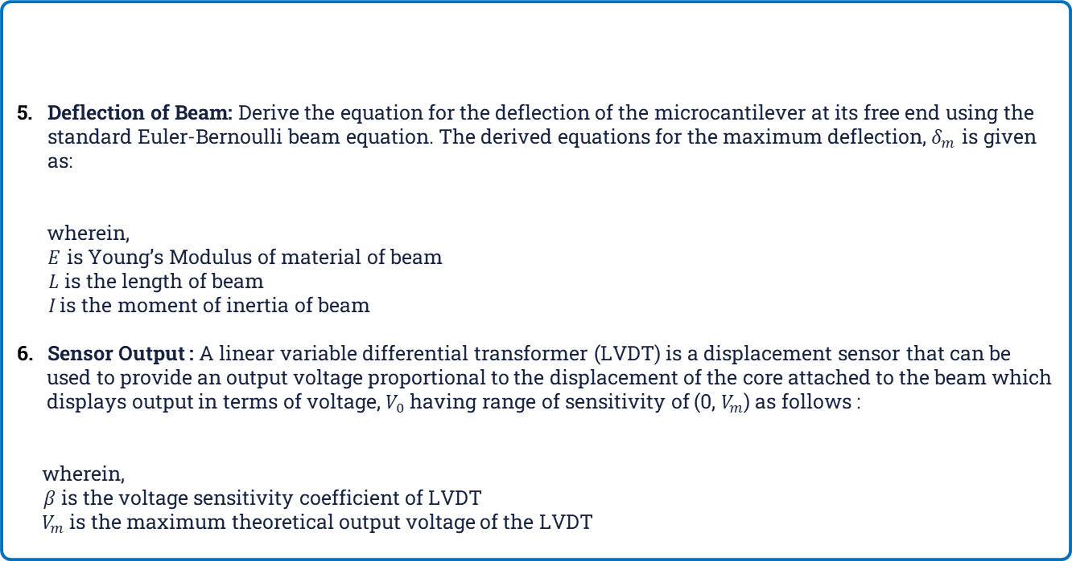


Structural Analysis : Modelling Methodology
Deflection of Beam: Derive the equation for the deflection of the microcantilever at its free end using the standard Euler-Bernoulli beam equation. The derived equations for the maximum deflection, $δ_{m}$ is given as:
wherein,
$E$ is Young’s Modulus of material of beam
$L$ is the length of beam
$I$is the moment of inertia of beam
Sensor Output : A linear variable differential transformer (LVDT) is a displacement sensor that can be
used to provide an output voltage proportional to the displacement of the core attached to the beam which
displays output in terms of voltage, $V_{0}$ having range of sensitivity of (0, $V_{m}$) as follows :
wherein,
$β$ is the voltage sensitivity coefficient of LVDT
$V_{m}$is the maximum theoretical output voltage of the LVDT
Assumption : The change in surface tension is only considered for inducing a bending moment in the beam. Hence, it can be equivalently considered as UDL of intensity, $γ_{s}$ per unit length of beam in this situation.
$$δ_{m}=\frac{γ_{s}L^{4}}{8EI}$$
$$V_{0}=βV_{m}δ_{m}$$

Slide 11

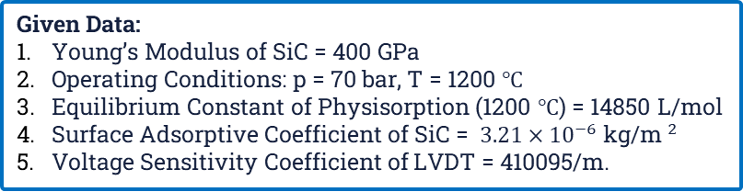
Structural Analysis : Problem Statement
In a liquid-propellant rocket engine, a microsensor is used for detecting the concentration of hydrogen gas (H₂) in the combustion chamber. The sensor system can be modelled as a microcantilever beam made up of Silicon Carbide (SiC) which adsorbs the gas molecules. The dimensions of the beam are shown as follows. A catalytic layer of Palladium (Pd) is deposited on the cantilever surface, which selectively binds H₂ molecules as a result of physical adsorption (physisorption). This causes a change in the surface tension of the surface due to adsorbed gas molecules which can be approximated as a UDL having intensity of this change in surface tension. This further leads to deflection of the beam which is measured using a linear variable differential transformer having range of (0, 12 V) attached at the free end. At a certain instant, the output voltage displayed by the LVDT is 7.842 volts. Assuming ideal behaviour of the gases, determine the concentration of the H₂ gas at this instant (in ppm).
Given Data:
Young’s Modulus of SiC = 400 GPa
Operating Conditions: p = 70 bar, T = 1200 $℃$
Equilibrium Constant of Physisorption (1200 $℃$) = 14850 L/mol
Surface Adsorptive Coefficient of SiC = $3.21×{10}^{−6}$ kg/m$^{2}$
Voltage Sensitivity Coefficient of LVDT = 410095/m.

Slide 12
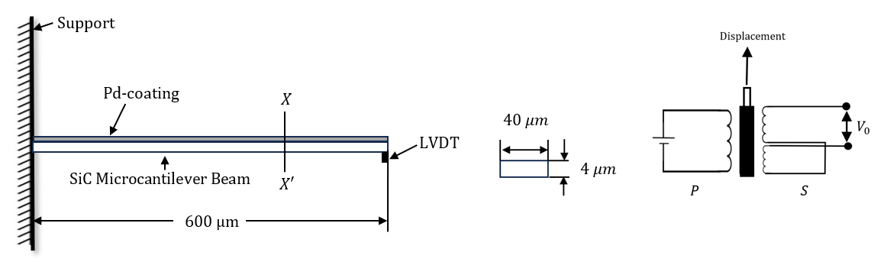
Structural Analysis : Problem Diagram
Beam Configuration
Section X-X’
LVDT Cross-section

Slide 13
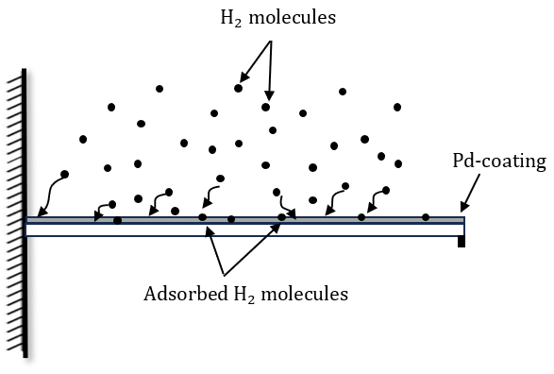
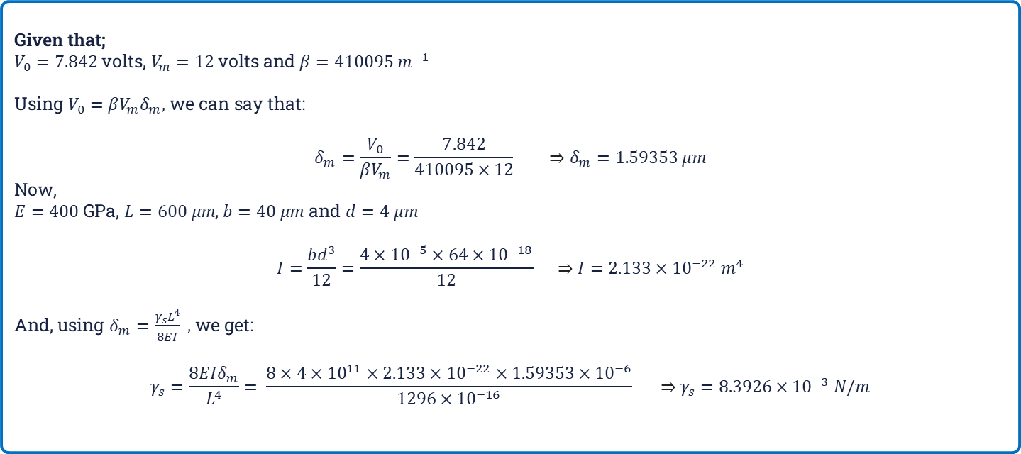
Structural Analysis : Detailed Approach
Given that;
$V_{0}=7.842$ volts, $V_{m}=12$volts and $β=410095 m^{−1}$
Using $V_{0}=βV_{m}δ_{m},$ we can say that:
$$δ_{m}=\frac{V_{0}}{βV_{m}}=\frac{7.842}{410095×12} ⇒δ_{m}=1.59353 μm$$
Now,
$E=400$ GPa, $L=600 μm$, $b=40 μm$ and $d=4 μm$
$$I=\frac{bd^{3}}{12}=\frac{4×{10}^{−5}×64×{10}^{−18}}{12} ⇒I={2.133×10}^{−22} m^{4}$$
And, using $δ_{m}=\frac{γ_{s}L^{4}}{8EI} ,$we get:
$$γ_{s}=\frac{8EIδ_{m}}{L^{4}}= \frac{8×4×{10}^{11}×{2.133×10}^{−22}×1.59353×{10}^{−6}}{1296×{10}^{−16}} ⇒γ_{s}=8.3926×{10}^{−3} N/m$$
Physisorption of H₂ molecules on Pd-surface

Slide 14
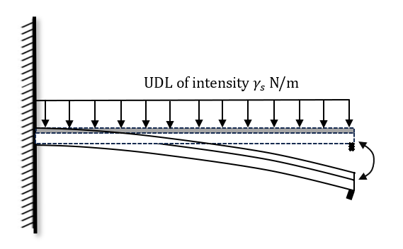
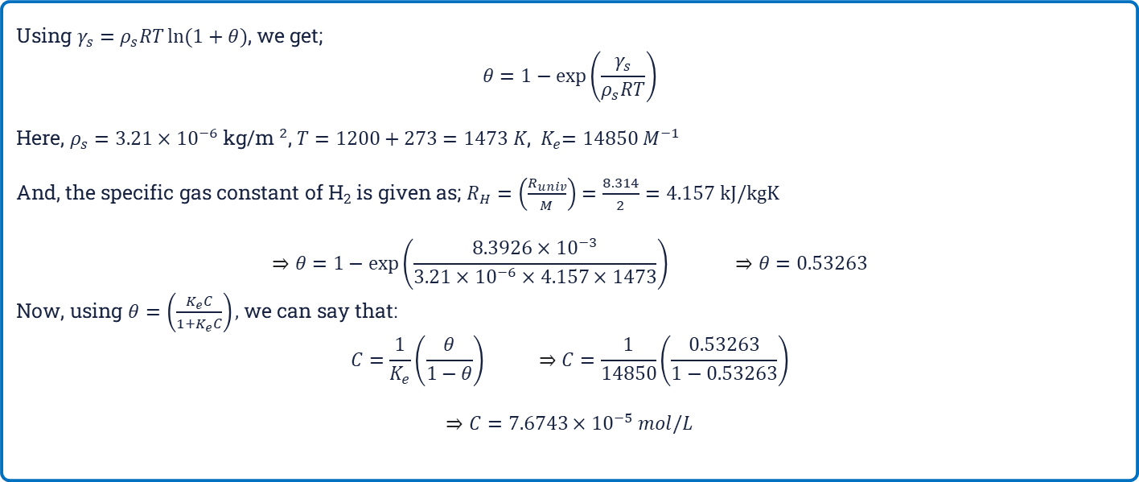
Structural Analysis : Detailed Approach
Using $γ_{s}=ρ_{s}RT\ln{(1+θ)}$, we get;
$$θ=1−\exp\left(\frac{γ_{s}}{ρ_{s}RT}\right)$$
Here, $ρ_{s}=$ $3.21×{10}^{−6}$ kg/m$^{2}$, $T=1200+273=1473 K$,${ K}_{e}=14850 M^{−1}$
And, the specific gas constant of H₂ is given as; $R_{H}=\left(\frac{R_{univ}}{M}\right)=\frac{8.314}{2}=4.157 kJ/kgK$
$$⇒θ=1−\exp\left(\frac{8.3926×{10}^{−3}}{3.21×{10}^{−6}×4.157×1473}\right) ⇒θ=0.53263$$
Now, using $θ=\left(\frac{K_{e}C}{1+K_{e}C}\right),$we can say that:
$$C=\frac{1}{K_{e}}\left(\frac{θ}{1−θ}\right) ⇒C=\frac{1}{14850}\left(\frac{0.53263}{1−0.53263}\right)$$
$$⇒C=7.6743×{10}^{−5} mol/L$$
Deflection of microcantilever beam due to physisorption

Slide 15

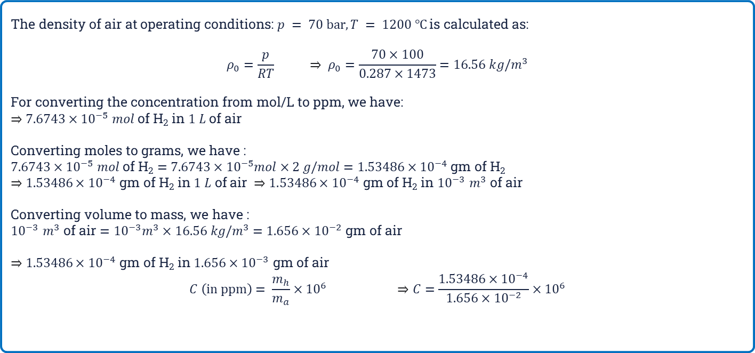
Structural Analysis : Detailed Approach
The density of air at operating conditions: $p = 70 bar, T = 1200 ℃$is calculated as:
$$ρ_{0}=\frac{p}{RT} ⇒ ρ_{0}=\frac{70×100}{0.287×1473}=16.56 kg/m^{3}$$
For converting the concentration from mol/L to ppm, we have:
$⇒$ $7.6743×{10}^{−5} mol$ of H₂ in $1 L$ of air
Converting moles to grams, we have :
$7.6743×{10}^{−5} mol$ of H₂ $=7.6743×{10}^{−5}mol×2 g/mol$ $=1.53486×{10}^{−4}$ gm of H₂
$⇒$ $1.53486×{10}^{−4}$ gm of H₂ in $1 L$ of air $⇒$ $1.53486×{10}^{−4}$ gm of H₂ in ${10}^{−3}$ $m^{3}$ of air
Converting volume to mass, we have :
${10}^{−3}$ $m^{3}$ of air $={10}^{−3}m^{3}×16.56 kg/m^{3}$ $=1.656×{10}^{−2}$ gm of air
$⇒$ $1.53486×{10}^{−4}$ gm of H₂ in $1.656×{10}^{−3}$ gm of air
$$C \left(in ppm\right)= \frac{m_{h}}{m_{a}}×{10}^{6} ⇒C=\frac{1.53486×{10}^{−4}}{1.656×{10}^{−2}}×{10}^{6}$$
$$C=9290.2174 \text{ppm}$$

Slide 16

References
#Research Papers, Publications & Journals
L.-Y. Chen, G. W. Hunter, P. G. Neudeck, D. Knight; C. C. Liu, and Q. H. Wu, "SiC-Based Gas Sensors", proceedings of the 190 th Meeting of the Electrochemical Society, San Antonio, TX., 1996 and references therein
Albrecht TR, Grütter P, Horne D, Rugar D, Frequency modulation detection using high-Q cantilevers for enhanced force microscope sensitivity, Journal of Applied Physics, 69 (1991), pp 668–673.
T. A. Betts, C. A. Tripple, “Selectivity of chemical sensors based on
micro-cantilevers coated with thin polymer films,” Analytic Chimica Acta,
Vol.422, No.1, pp. 89-99, October 2000.
4. M. Blaschke, T. Tille, P. Robertson, et al, “MEMS gas-sensor array for
monitoring the perceived car-cabin air quality,” IEEE Sensors Journal,
Vol. 6, No. 5, pp. 1298-1307, October 2006.
5. H. P. Lang, J. P. Ramseyer, W. Grange, et al, “An artificial nose based on
microcantilever array sensors”, Journal of Physics: Conference Series,
Vol.61, pp. 663-667, 2007.
6. Almazán F, Urbiztondo M, Pina MP, Llobet E, Debéda H, Screen-Printed
PZT Cantilevers with de-aluminated type Y zeolites for BTX Detection,
IMCS Argentina 2014
#Websites
https://eepower.com/technical-articles/design-and-optimization-of-silicon-carbide-schottky-diode/#
https://www.sciencedirect.com/science/article/abs/pii/S221478532101899X
https://www.sciencedirect.com/science/article/pii/S221478532101899X

